Slide 1
dbms
Module 5 part 1

Slide 2
index
Transaction
ACID Properties
Concurrency control
Transaction Model
Transaction States
System Log

Slide 3
transaction
Transactions group a set of tasks into a single execution unit.
Each transaction begins with a specific task and ends when all the tasks in the group successfully complete.
If any of the tasks fail, the transaction fails. Therefore, a transaction has only two results: success or failure.
Incomplete steps result in the failure of the transaction.
A database transaction, by definition, must be atomic, consistent, isolated and durable. These are popularly known as ACID properties.

Slide 4
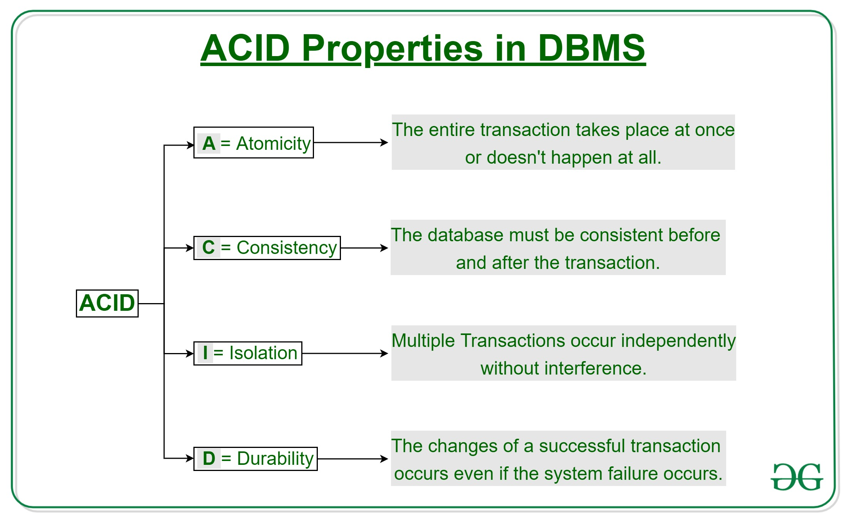

Slide 5
CONCURRENCY CONTROL
Concurrency Control in Database Management System is a procedure of managing simultaneous operations without conflicting with each other
Concurrency Control Protocols
Lock-Based Protocols
Two Phase Locking Protocol
Timestamp-Based Protocols
Validation-Based Protocols

Slide 6
1.LOCK-BASED PROTOCOLS
Lock Based Protocols in DBMS is a mechanism in which a transaction cannot Read or Write the data until it acquires an appropriate lock.
Lock based protocols help to eliminate the concurrency problem in DBMS for simultaneous transactions by locking or isolating a particular transaction to a single user.
All lock requests are made to the concurrency-control manager. Transactions proceed only once the lock request is granted.

Slide 7
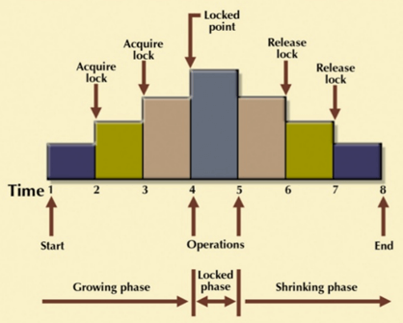
TWO PHASE LOCKING PROTOCOL (2 PL Protocol)
It is a method of concurrency control in DBMS that ensures serializability by applying a lock to the transaction data which blocks other transactions to access the same data simultaneously
Growing Phase: In this phase transaction may obtain locks but may not release any locks.
Shrinking Phase: In this phase, a transaction may release locks but not obtain any new lock

Slide 8
TIMESTAMP-BASED PROTOCOLS
It is an algorithm which uses the System Time or Logical Counter as a timestamp to serialize the execution of concurrent transactions.
It ensures that every conflicting read and write operations are executed in a timestamp order.
The older transaction is always given priority in this method.
It uses system time to determine the time stamp of the transaction.
This is the most commonly used concurrency protocol.

Slide 9
VALIDATION BASED PROTOCOL
It is also called Optimistic Concurrency Control Technique.
It is called optimistic because of the assumption it makes, i.e. very less interference occurs, therefore, there is no need for checking while the transaction is executed.
Until the transaction end is reached updates in the transaction are not applied directly to the database. All updates are applied to local copies of data items kept for the transaction. At the end of transaction execution, while execution of the transaction, a validation phase checks whether any of transaction updates violate serializability. If there is no violation of serializability the transaction is committed and the database is updated

Slide 10
Transaction Model
Transactions access data using two operations:
• read(X), which transfers the data item X from the database to a variable, also called X, in a buffer in main memory belonging to the transaction that executed the read operation.
• write(X), which transfers the value in the variable X in the main-memory buffer of the transaction that executed the write to the data item X in the database.

Slide 11
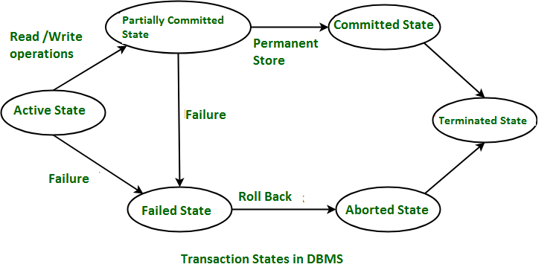
Transaction States
Active State:When the instructions of the transaction are running then the transaction is in active state. If all the ‘read and write’ operations are performed without any error then it goes to the “partially committed state”; if any instruction fails, it goes to the “failed state”.
Partially Committed:After completion of all the read and write operation the changes are made in main memory or local buffer. If the the changes are made permanent on the Data Base then the state will change to “committed state” and in case of failure it will go to the “failed state”.
Failed State:When any instruction of the transaction fails, it goes to the “failed state”

Slide 12

Aborted State :After having any type of failure the transaction goes from “failed state” to “aborted state”
Committed State:It is the state when the changes are made permanent on the Data Base and the transaction is complete and therefore terminated in the “terminated state”.
Terminated State :the transaction comes from the “committed state” goes to this state, then the system is consistent and ready for new transaction and the old transaction is terminated.

Slide 13
System Log
Log is a sequence of records, which maintains the records of actions performed by a transaction.
It is important that the logs are written prior to the actual modification and stored on a stable storage media, which is failsafe.
Log-based recovery works as follows −
The log file is kept on a stable storage media.
When a transaction enters the system and starts execution, it writes a log about it.
<Tn, Start>
When the transaction modifies an item X, it write logs as <Tn, X, V1, V2>.It reads Tn has changed the value of X, from V1 to V2.
When the transaction finishes, it logs <Tn, commit>

Slide 14
THANK YOU

